Slide 1
Federal Health Information Modeling (FHIM)
Overview & Status Update
03/03/2011

Slide 2
Agenda
FHIM Overview
IM Project and FHIM Steering Group and Modeling Participants
FHIM and Associated Terminology Models Goal and Principles
FHIM updates
Terminalogy WG Kickoff

Slide 3
FHIM Overview
FHIM, the Federal Health Information Model, represents a collaborative partnership of agencies and organizations across all levels of government (federal, state, tribal, and local) and with private industry. The purpose of FHIM is to effectively and efficiently share critical information at key decision points throughout the healthcare enterprise. The Federal Health Architecture (FHA) serves as the lead partner for FHIM.
Goals
Communicate the specific requirements to building and importing models to the Federal Health Information Model (FHIM)
Ancillary artifacts that address the information needs of a broad range of federal stakeholders
Outline the FHIM Mechanisms for synthesizing the domain/business knowledge of subject-matter experts
Show artifact reuse across FHIM projects by outlining artifact consistency.
Leverage open industry standards that are familiar to most business analysts, architects, and other technology professionals
Share valuable lessons learned and best practices

Slide 4

IM Project and FHIM Steering Group and Modeling Participants
Steering Group Members:
DoD [Nancy Orvis]
SSA [Justine Piereman]
CDC [Nikolay Lipskiy]
VHA [Tim Cromwell]
NCI [George Komatsoulis]
CMS [Theresa Lissauer
Information Modeling Project comprised of volunteers from:
DoD/MHS | CDC
VA / VHA | SSA
HHS | SAMHSA
CMS | IHS
FDA | NCI
NLM | FHA
All are encouraged to invite
Subject Matter Experts (SMEs)
from their respective organizations
to provide insight and input on
models, standards, and definitions.
4

Slide 5
FHIM and Associated Terminology Models Goal and Principles
Goal
Produce a logical, health information model that supports semantic interoperability and that is built by harmonizing information from the individual Federal partners and standards organizations
Principles
The model will be expressed in standard Unified Modeling Language (UML) notation (it may also be expressed in other notations)
The model will be designed to meet all Federal partner semantic interoperability needs for the exchange of information with other organizations
The model will support existing national health standards
The model will be in the public domain, freely available and easy to access
The model will be specified as a logical model consisting of a set of domain models
The model will not specify behaviors (operations) and, at least initially, will not specify OCL constraints or rules
The model will be made available as an XMI export
5

Slide 6
FHIM and Associated Terminology Models Current Status of Information Domain Modeling
Domains Already Modeled
Person
Security and Privacy
Eligibility, Enrollment, Coordination of Benefits
Behavioral Health Assessments
Problem
Developed response to PCAST Report (12/10)
Currently Being Modeled
Lab
Medications/Pharmacy (including immunizations)
Allergies
Terminalogy
Domains Scheduled to Be Modeled
Orders (General)
Vital Signs
Encounters
Ongoing work
Mapping to HL7 S-FM
Integration with ONC S&I Framework
Support for VA/DoD Joint Data Interoperability Effort (CIIF)
6

Slide 7
FHIM Modeling Update
Domain Model | Lead Modelers/ Participants | Update | Meeting Information
Allergy Domain | Steve Wagner (PM) Galen Mulroney (VA) Jim McKim Mike Fitch Mumtaz Karamete Molly McMorrow | Allergy Domain Workbook created (v6) Allergies has started formal information modeling work and expects to complete their first iteration domain modeling in 2-3 weeks | Name: FHIMS WG Allergy Domain Recurring Weekly Call Every Monday Time of the call: 2:00 - 3:00 PM EDT
Medication Management/ Pharmacy | Steve Wagner Galen Mulroney (VA) Kosta Makrodimitris Mitra Rocca Steve Hufnagel | First iteration is currently in development | Name: FHIMS WG Medications/Pharmacy domain modeling call Recurring Weekly Call Every Monday Time of Call: 3:00 - 4:00 PM EDT
Laboratory | Steve Wagner (PM) | Laboratory team started on the 3rd iteration of the information model | Name: FHIMS WG Laboratory Domain Recurring Weekly Call Every Monday Time of Call: 10:00 - 11:30 AM EDT
Terminalogy Management | Steve Wagner (PM) | The PMO indicated that he would provide an update on the Terminology Modeling sub-project that is being formed. Three co-leads from VA, DoD and CDC have been confirmed and three formational calls have been held. | N/A

Slide 8
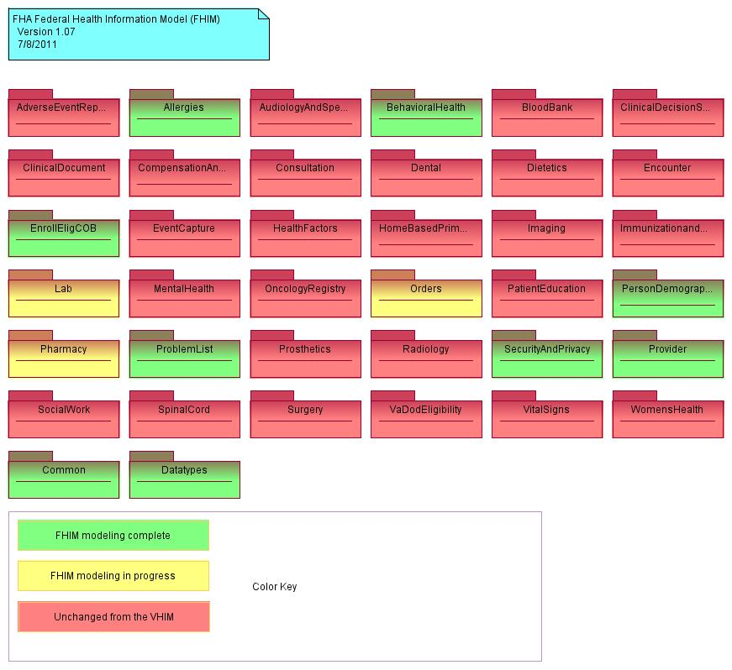
FHIM Domains

Slide 9
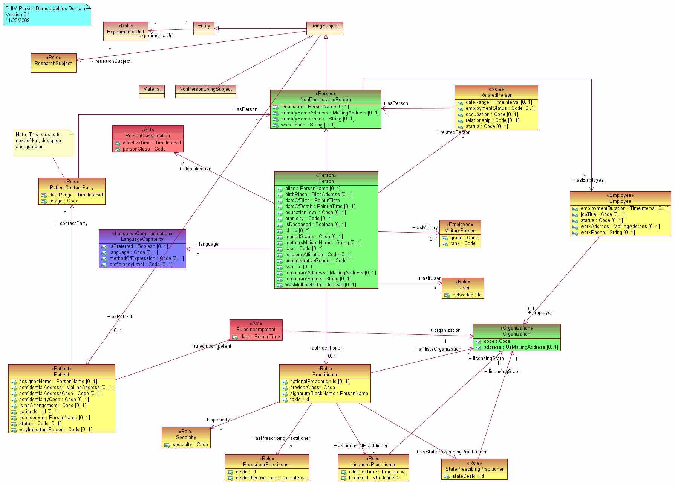
Example UML Domain Model : Person Demographic
Based on HL7 RIM Classes
(Entity, Role, Act, etc.)
Use of HL7 RIM Color Scheme
Entity
Related Person
ATTRIBUTES
alias : PersonName [0..*] ethnicity : Code [0..*] maritalStatus : Code [0..1] mothersMaidenName : String [0..1] race : Code [0..*]
Administrative Gender : Code
Person
Language
Military Person
Organization
Practitioner
Types of Practitioners
10

Slide 10
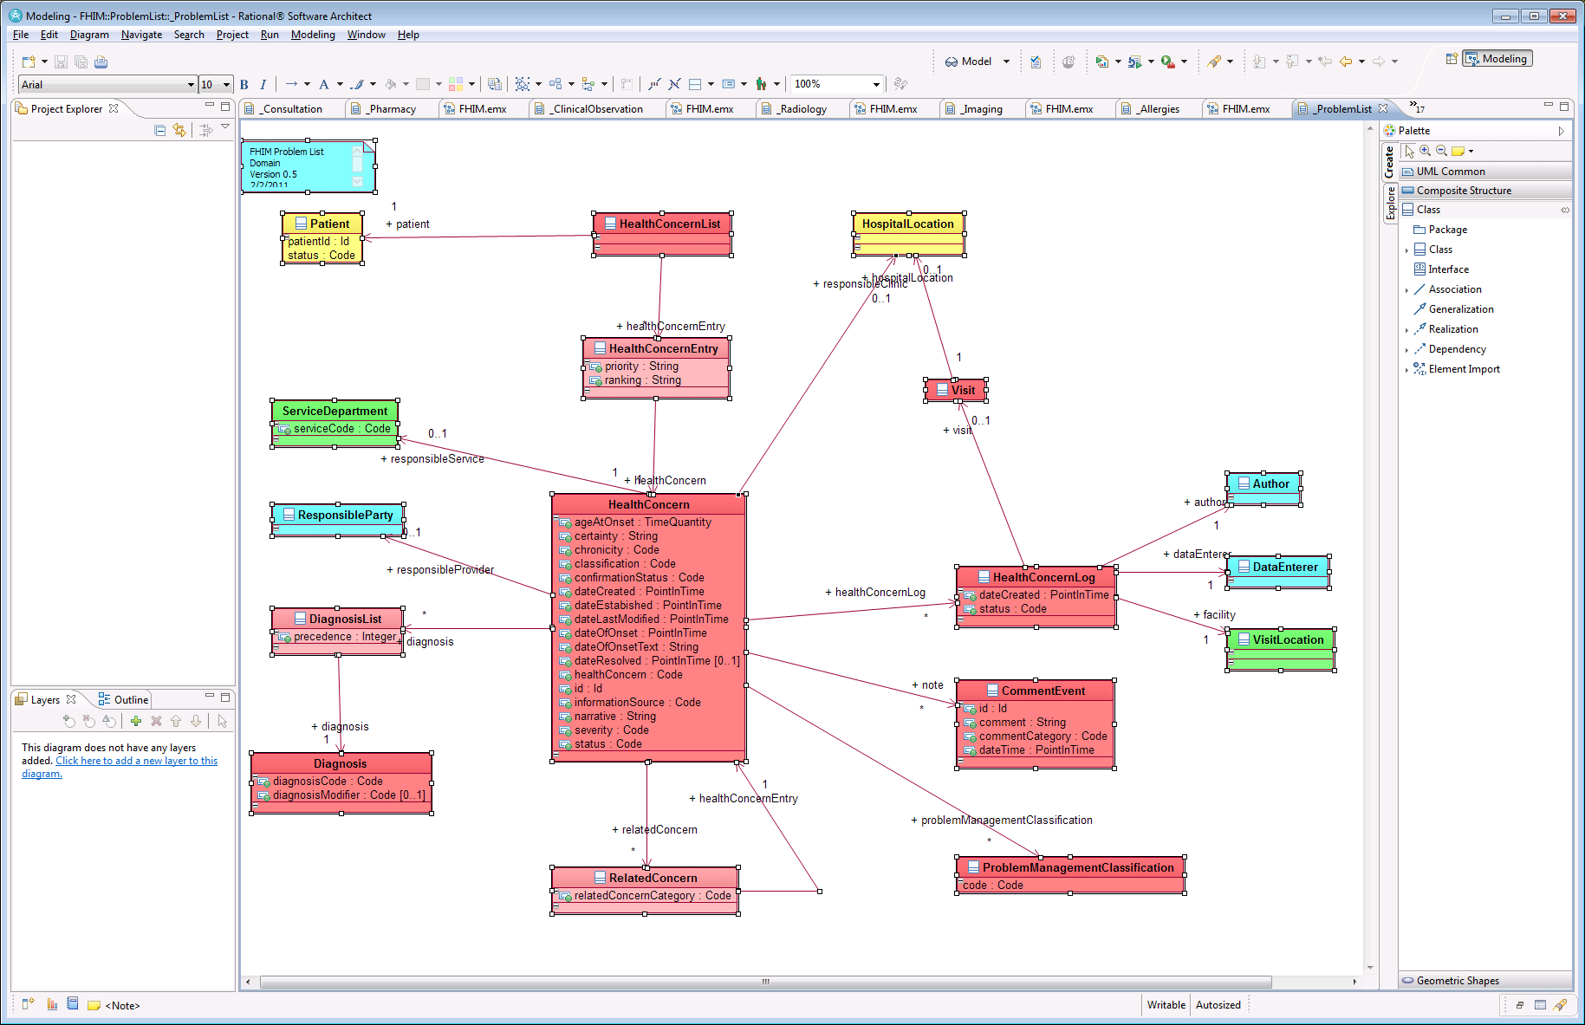
Modeling Problem Domain with IBM Rational System Architect (RSA)

Slide 11
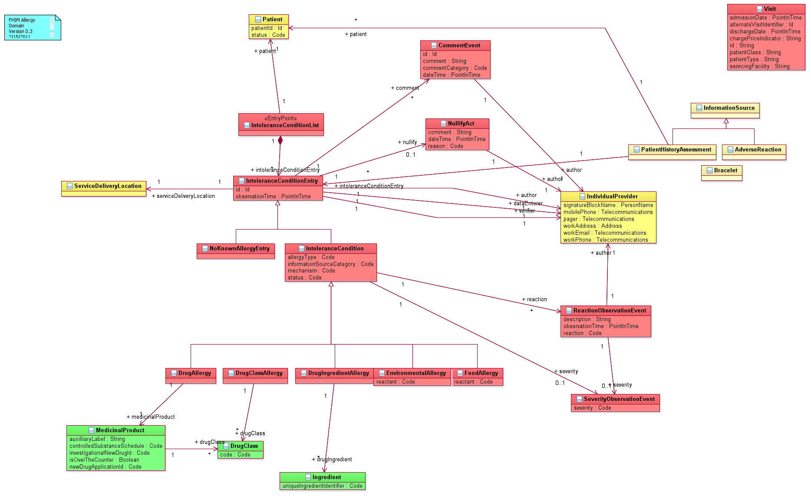
FHIM Allergy Domain

Slide 12
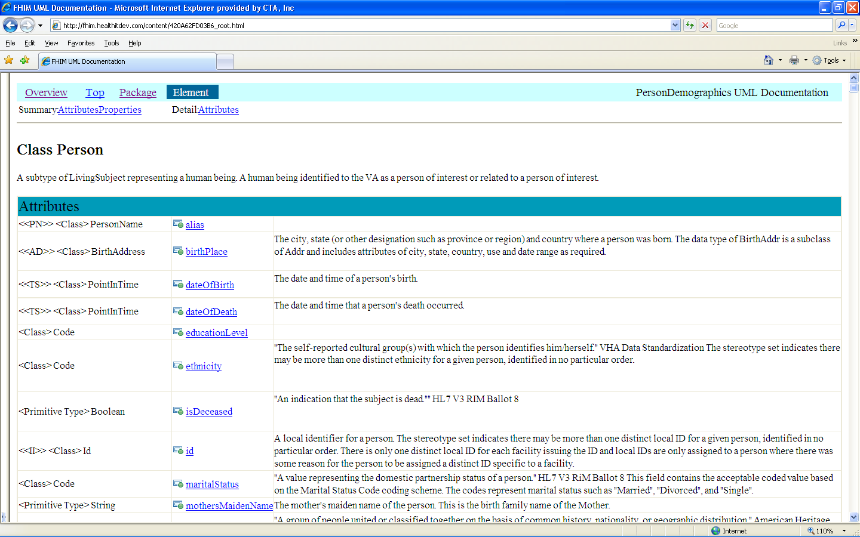
Example: Class Documentation / Definition
Currently have wiki for collaboration
Need to get user and password
SVN server holds all documents and models
11

Slide 13
Model Driven Architecture (MDA) View Describing Relationship Between FHIM and NIEM
Business Models
(BPMN & BPEL)
Used to Generate
Used to Generate
Software Behavior Models
(UML)
Logical (Static) Information Models
(UML)
Used to Generate
This is
FHIM
Used to Generate
Used to Generate
Used to Generate
Information Exchange (IEPD) Models
(XML Schemas)
Physical Databases
(Relational or Other DB)
This is NIEM
Used to Generate

Slide 14
Model Driven Architecture (MDA) View
Integration of FHIM, NIEM, HITSP and Health SDOs
Federal Health Information Model (FHIM)
Contribute
Data To
Provides
Information
To
Contributes
Data To
HITSP
Contributes
Data To
Open Health Tools (OHT)
UML Tools
Health SDOs
HL7 & Others
Contributes
Process To
NIEM
Contributes
Process To
Produces
Contributes
Process To
XML Schema
IE Documentation
Certification Criteria

Slide 15
FHIM and Associated Terminology Models Benefits
The models retain use case context
The models are integrated (2-way links between Information Terminology models)
The modeling process harmonizes content (information and terminology) across organizations
The models support efficient standards development
The models are being integrated with the MDHT to support a model-driven approach to development of information exchange interoperability specifications
The models can be leveraged by organizations for internal use in systems and database development
The models are developed using standard UML

Slide 16

FHIM Model Driven Prototype
Approach
FHIM Model
(PIM)
1
NIEM Health Domain
Harmonized
Uses
Lab Domain Integration Use Case
Constrains
2
Uses
Platform Independent
Lab Domain Exchange (PIM)
4
5
Platform Specific
MDHT
Transform
CDA Exchange PSM (UML)
NIEM Exchange PSM (UML)
8
Generate
Transform
Transform
Generate
9
6
7
CDA Implementation Guide Document
CDA Exchange Implementation
(Java)
NIEM Exchange PSM Implementation
(XSDs)
NIEM IEPD
Document

